Slide 1
KITTUR RANI CHANNAMMA EDUCATION SOCIETY’S ANNASAHEB BOMMANAIK PATIL COLLEGE OF EDUCATION, BAILHONGAL
BEST PRACTICE

Slide 2
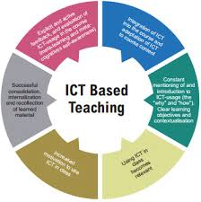
BEST PRACTICE No.1
ICT for effective Teaching Learning

Slide 3
Student teacher has a scope of learning some of the subjects on ICT Basic, ICT Application, Innovative Lessons and ICT based lessons in different semester.
But the syllabus prescribes only theoretical in nature.
Due to the Advancement of current pedagogical methods, students are deprived of practical experiments.
Principal along with IQAC resolved to facilitate students on practical knowledge of ICT.

Slide 4
Extended Facilities are ;
Well Equipped computer laboratory with 25 well configured desktops.
Installed language related E-learning resources to gain English Communication Skills, Computer Typewriting, MS-Office.
Facilitated high band width internet connectivity and wi fi provision.
Collaborative activities with Agasta Foundation, Deshpande Foundation and Infosys – Spring.
Appointed expert to engage both theory and practical sessions.

Slide 5
Activities:
Organized 03 days programme on, “Creative Skilling” by Agasta Foundation held on 22 -24 July, 2024.
Day 1 : Demonstrative lecture and hands on experience on “Adobe Photoshop” with the duration of 5 hrs.
Day 2 : Resume Writing Skills for outgoing students with 5 hrs duration.
Day 3 : PPT Preparation and Presentation for 5 hrs. duration.

Slide 6
Activities:
Organized 03 days programme on, “Creative Skilling” by Agasta Foundation held on 22 -24 July, 2024.
Organized PPT preparation competition on the topic, “Social Media – Pros & Cons” dated; 16.05.2022/
In association with Deshpande Foundation conducted a workshop on “Preparation of Teaching Aids” held on 24.06.2025.
Regular practical session on ICT and MS Office to the students.
Simulated teaching using ICT.

Slide 7
Impact:
Entire students were actively participated.
Outgoing students could able to prepare their resume using MS-Word Application comfortably.
Some of the students got specific knowledge and skills using Photoshop.
Teachers also got additional skills and knowledge on photoshop and other ICT techniques.
Majority of the students expressed their request to continue such activities continuously.

Slide 8
APPRECIATION AND CREDENTIALS:
LIC, Rani Channamma University has appreciated the effort by the college during their inspection.
Neighbouring B.Ed. college staff and student representatives impressed about the effort by the college.
Members of esteemed Management got motivation to further facilitate on ICT related infrastructure.
Sister concerned Institution also appreciated the effort towards enrichmental activities on ICT.

Slide 9
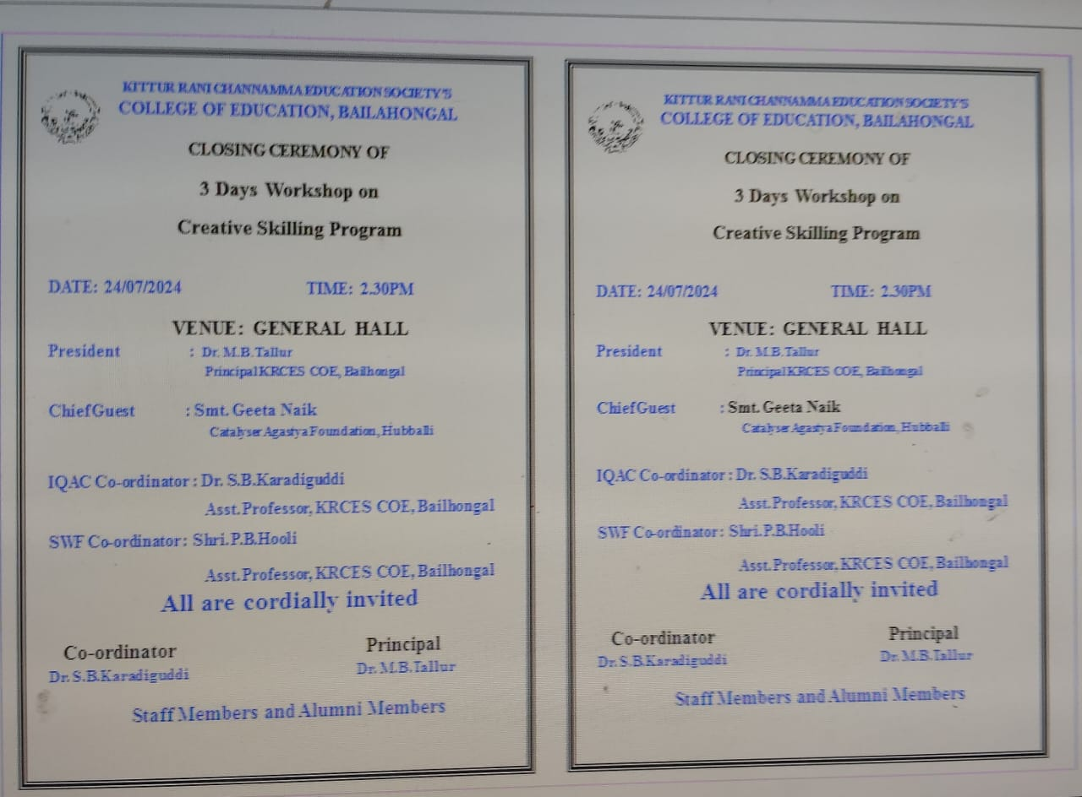

Slide 10
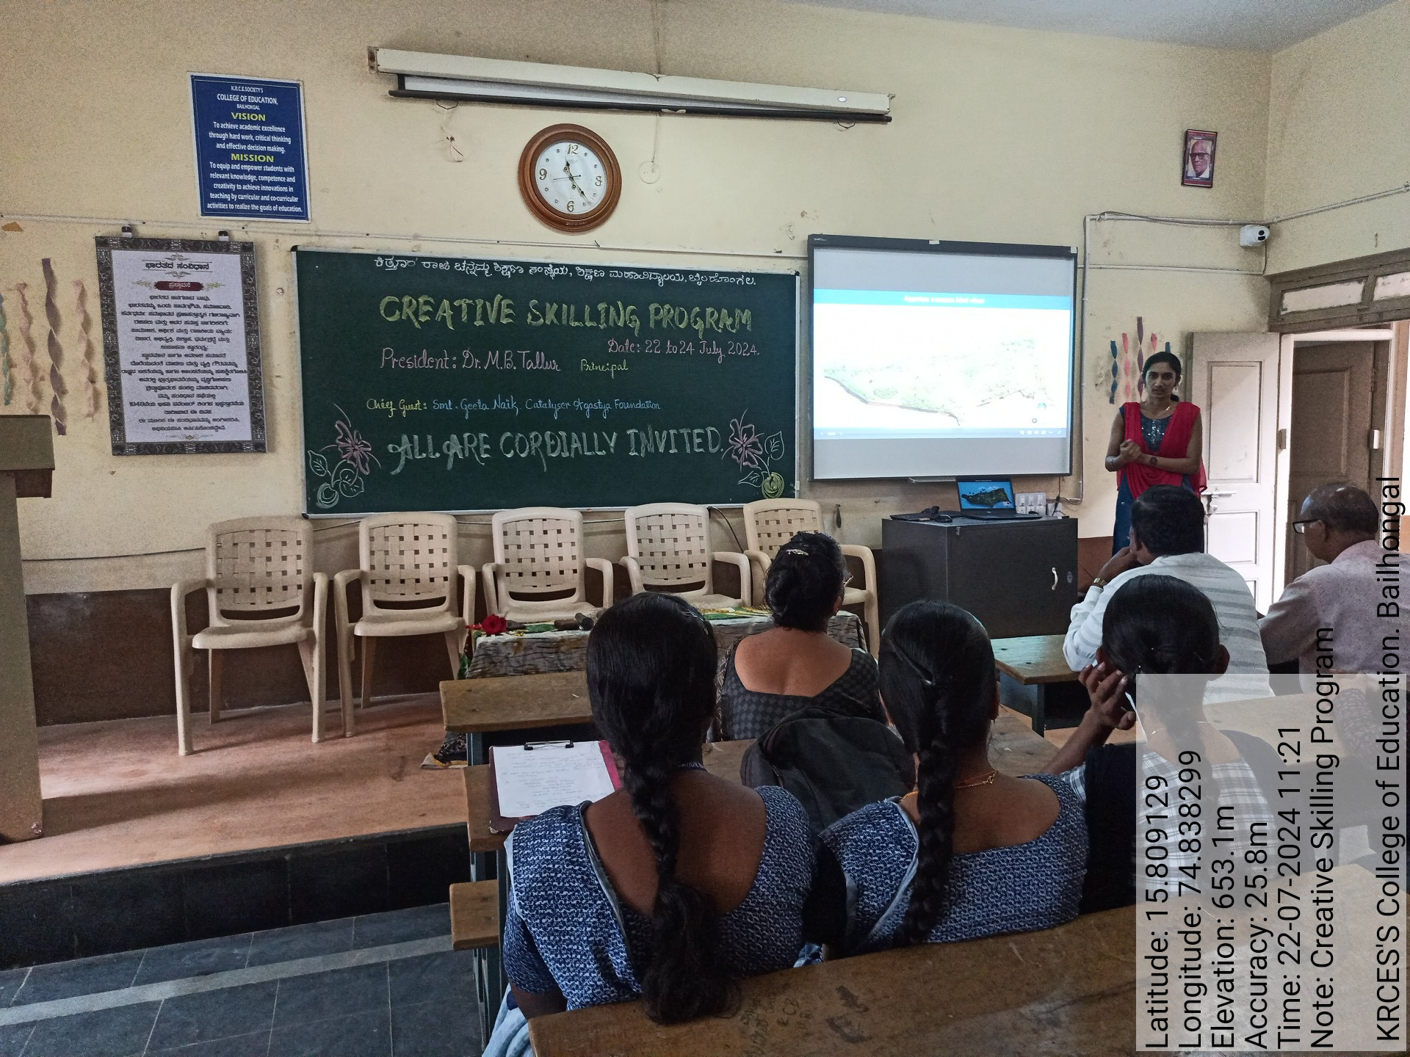

Slide 12
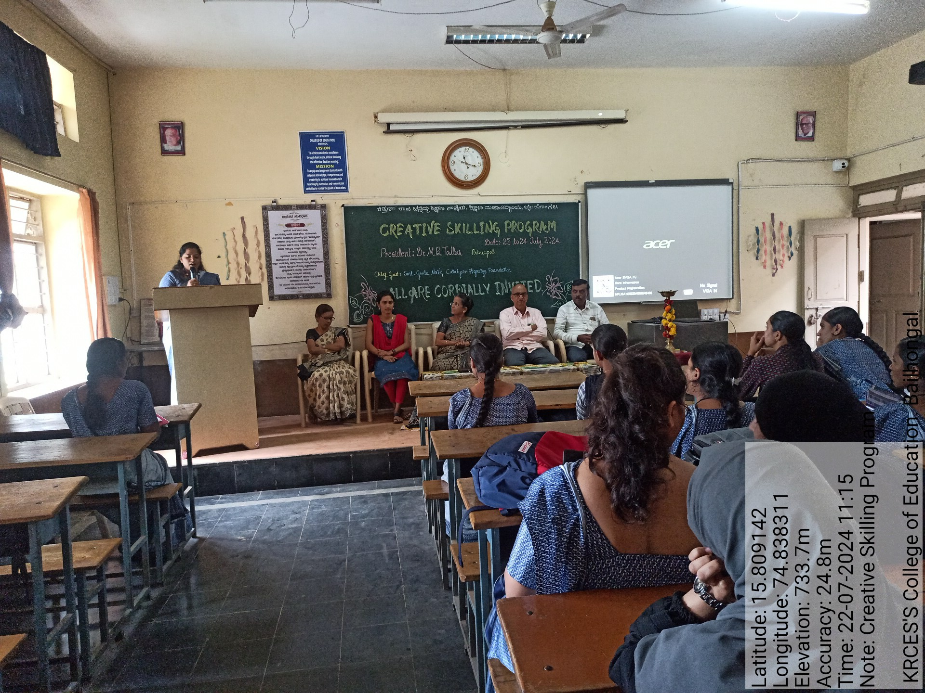

Slide 13



Slide 14
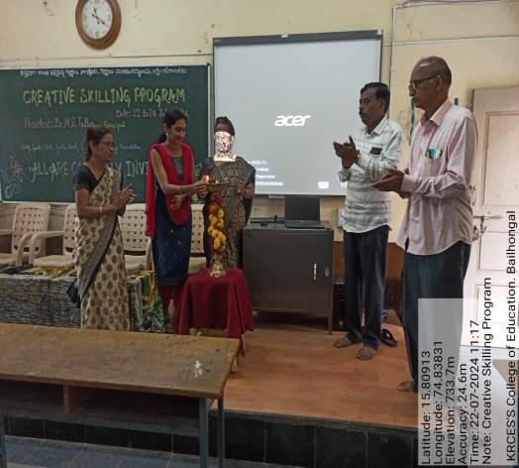
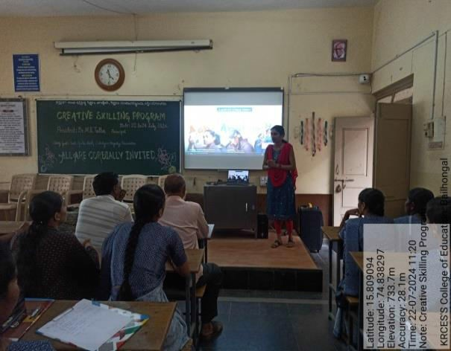
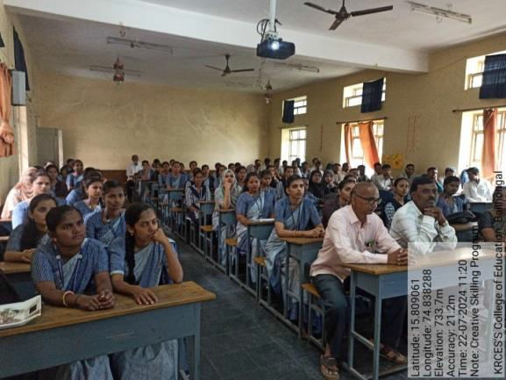
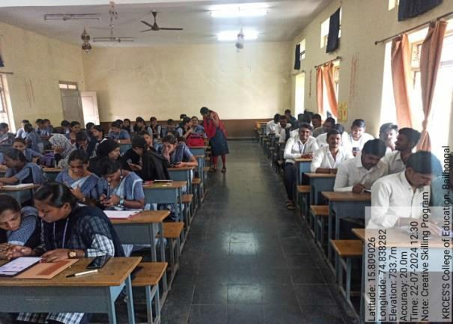
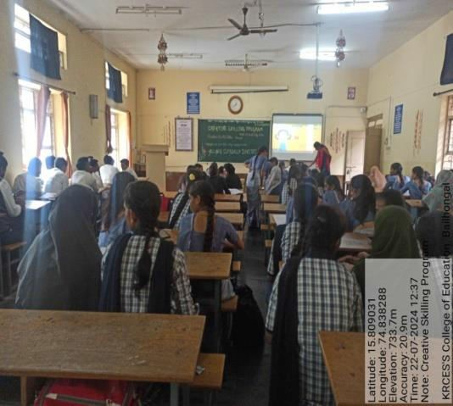
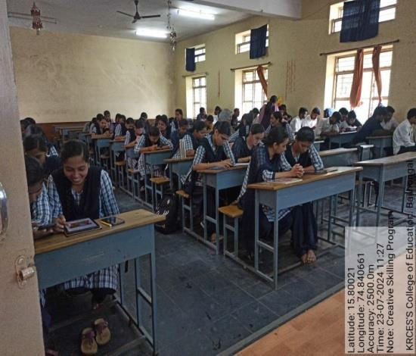
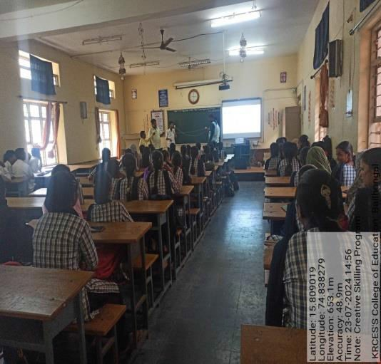
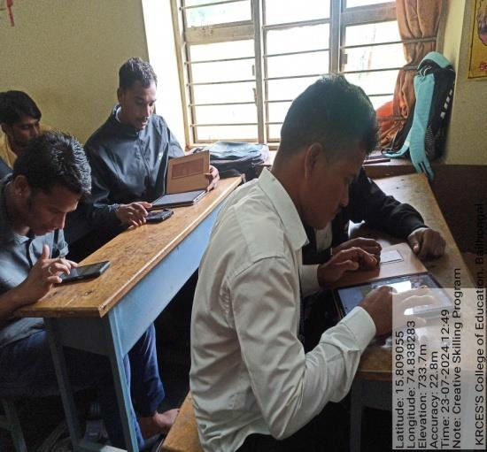
Geotagged photos of the activities.

Slide 15
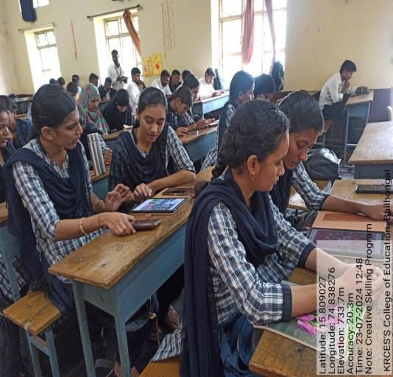
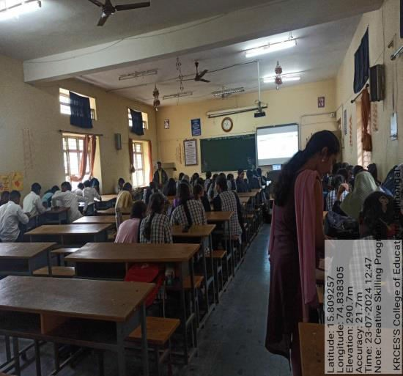
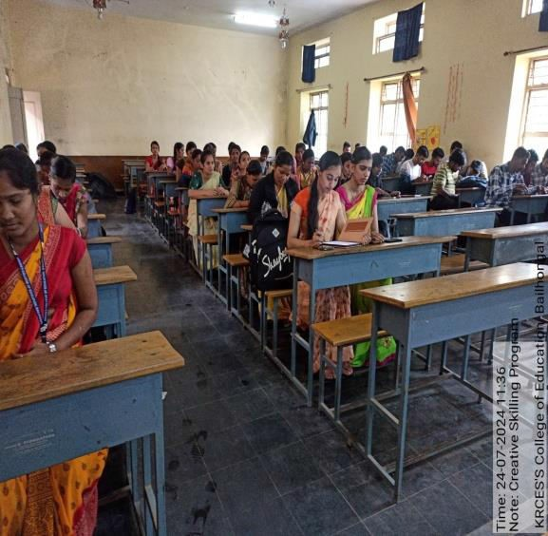
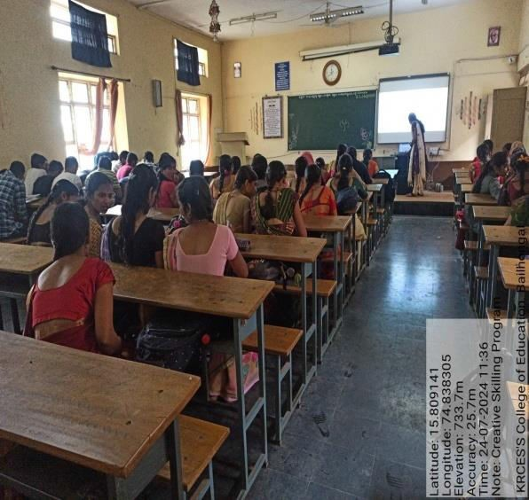
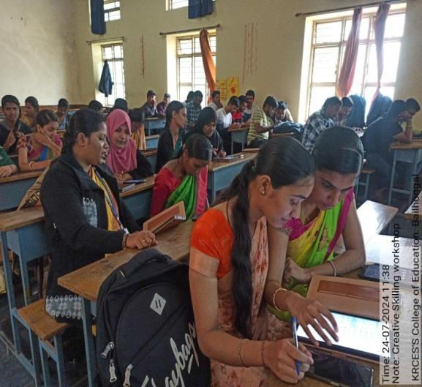
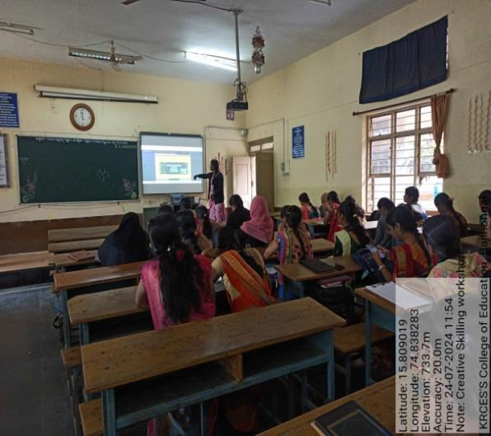
Geotagged Photos of the activities

Slide 16
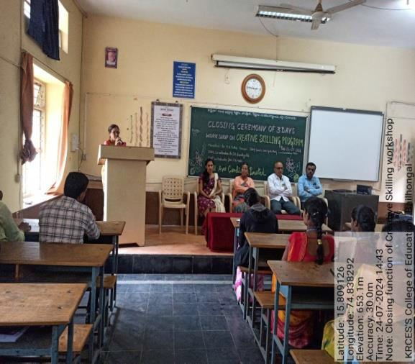
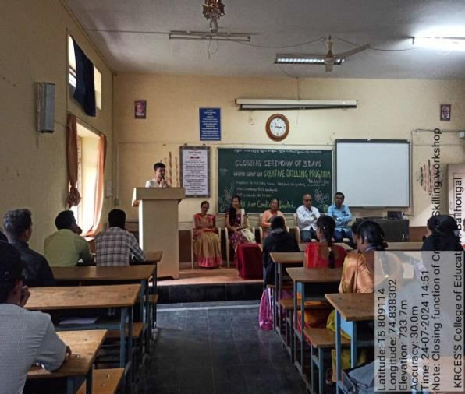
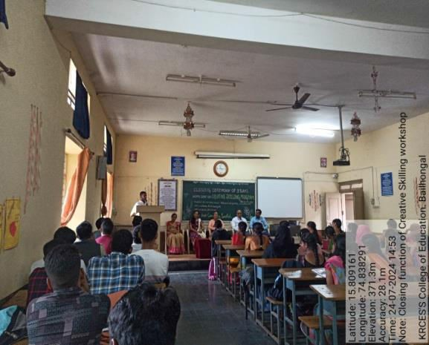
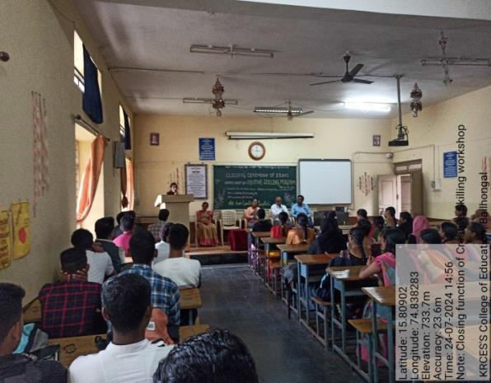
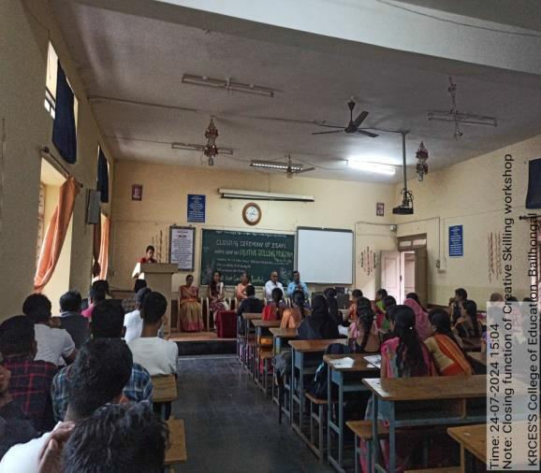
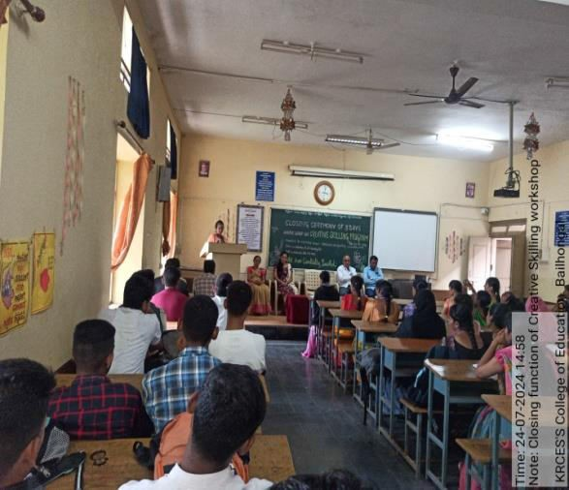
GEOTAGGED PHOTOS OF THE ACTIVITIES

Slide 17
Competition on “PPT preparation” on the topic of “Social Media – Pros and cons”.
After the necessary training to students, this competition was organized on 16.05.2022.
09 final year students actively participated in this competition.
All the participants were given participation certificate and trophy was given during annual gathering.

Slide 18
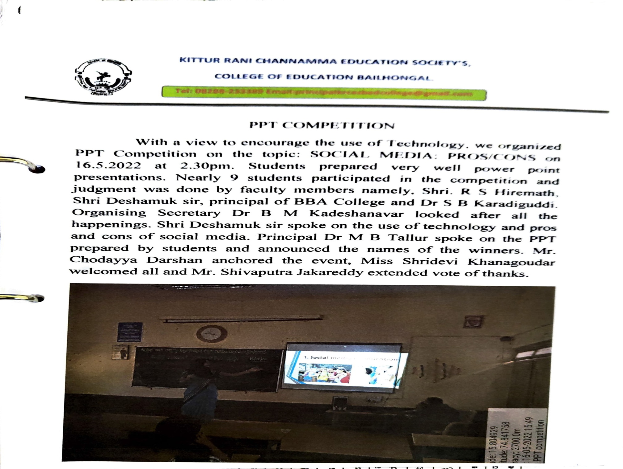

Slide 19
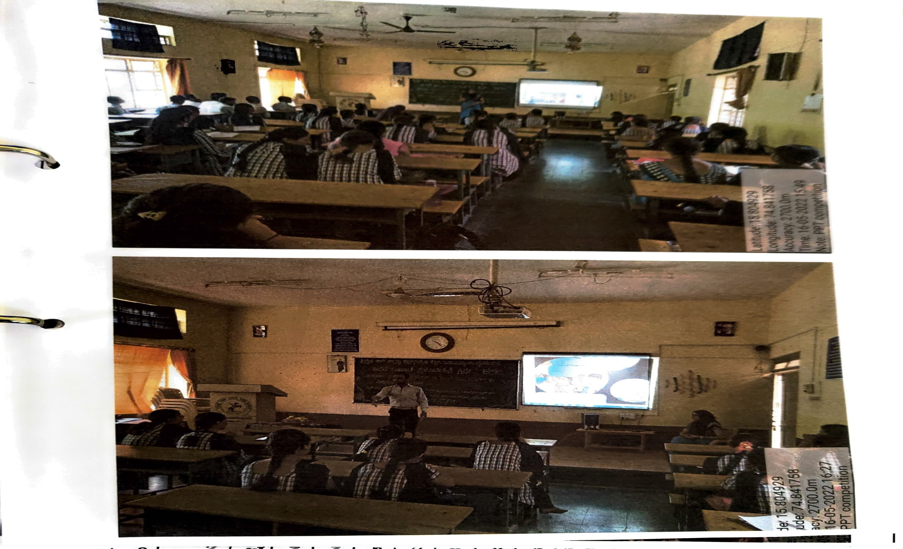
Geotagged photos of the activities.

Slide 20
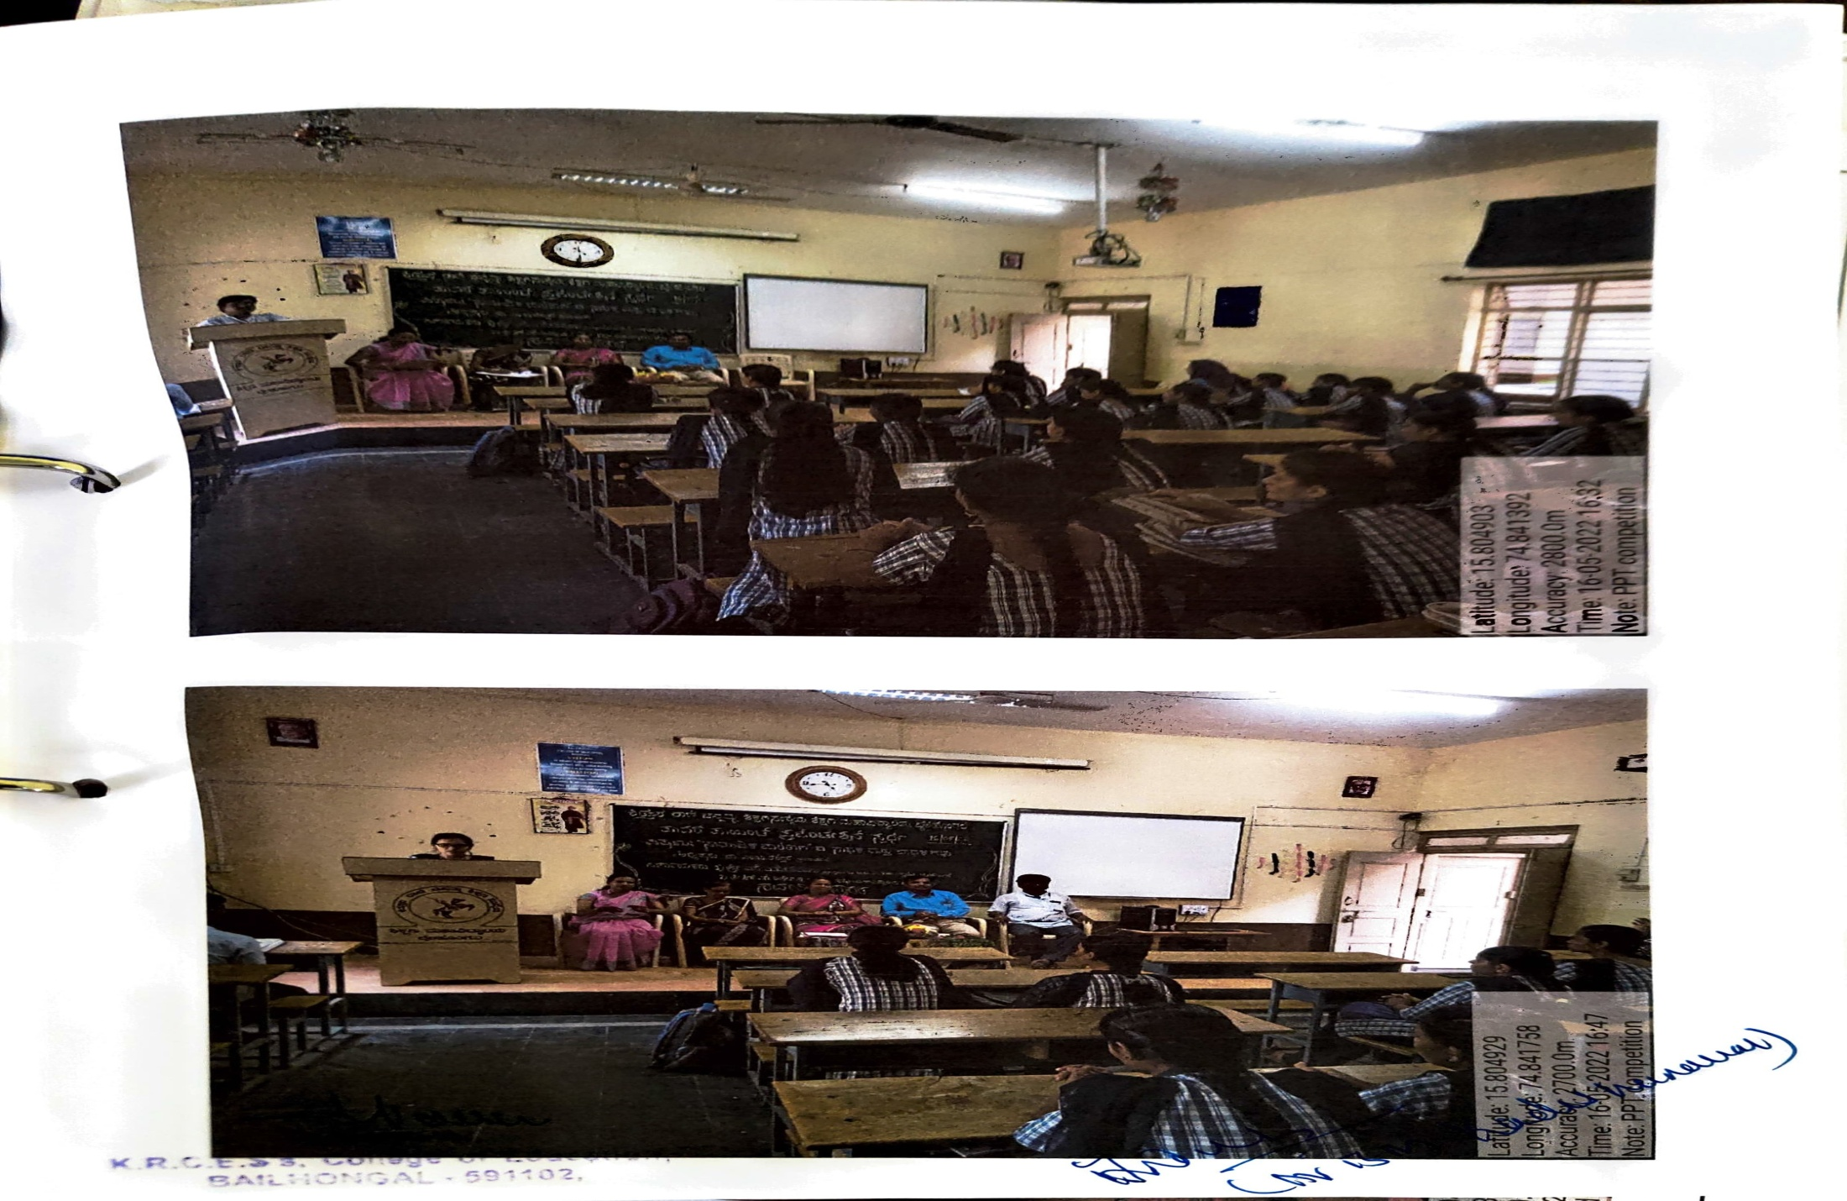
Geotagged photos of the activities.

Slide 21
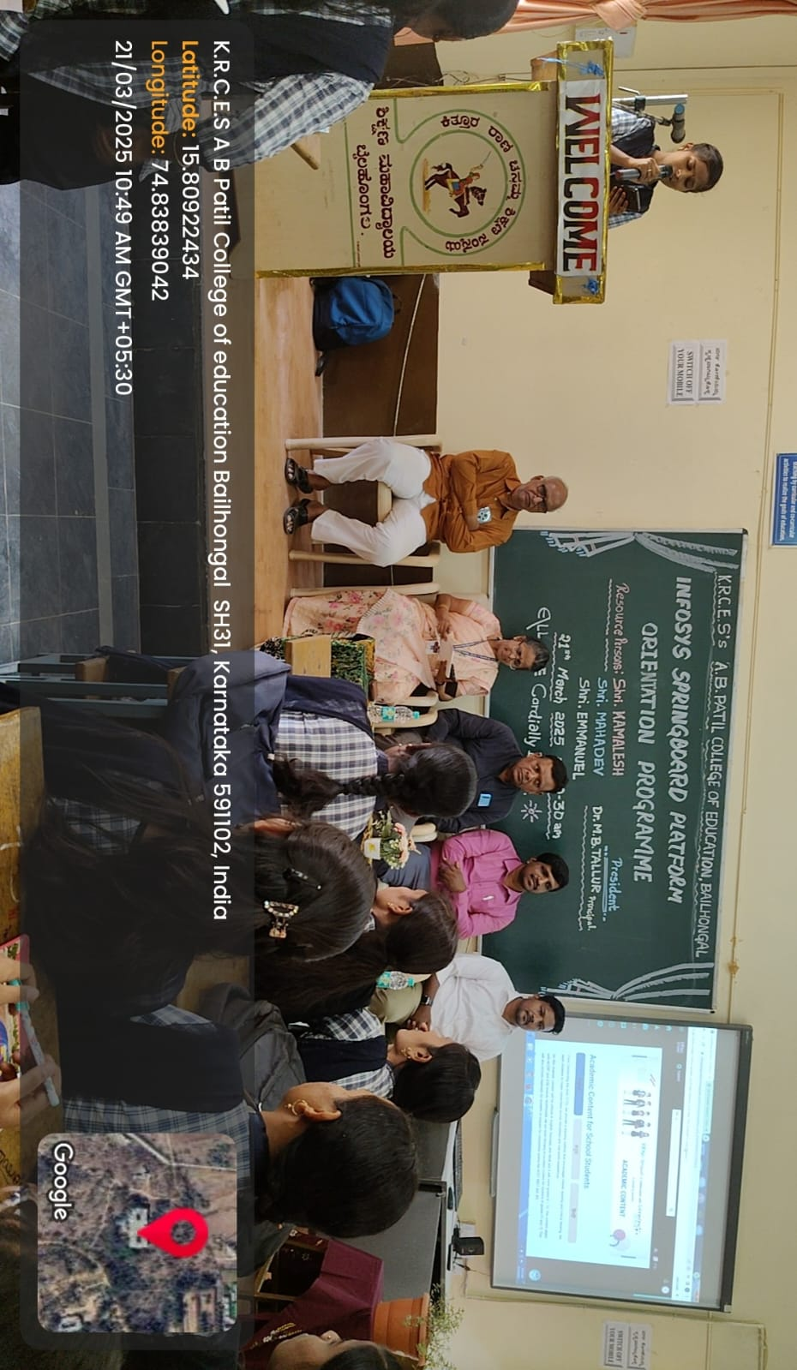
In association with Infosys conducted a workshop on “Spring App” held on 21.03.2025.

Slide 22
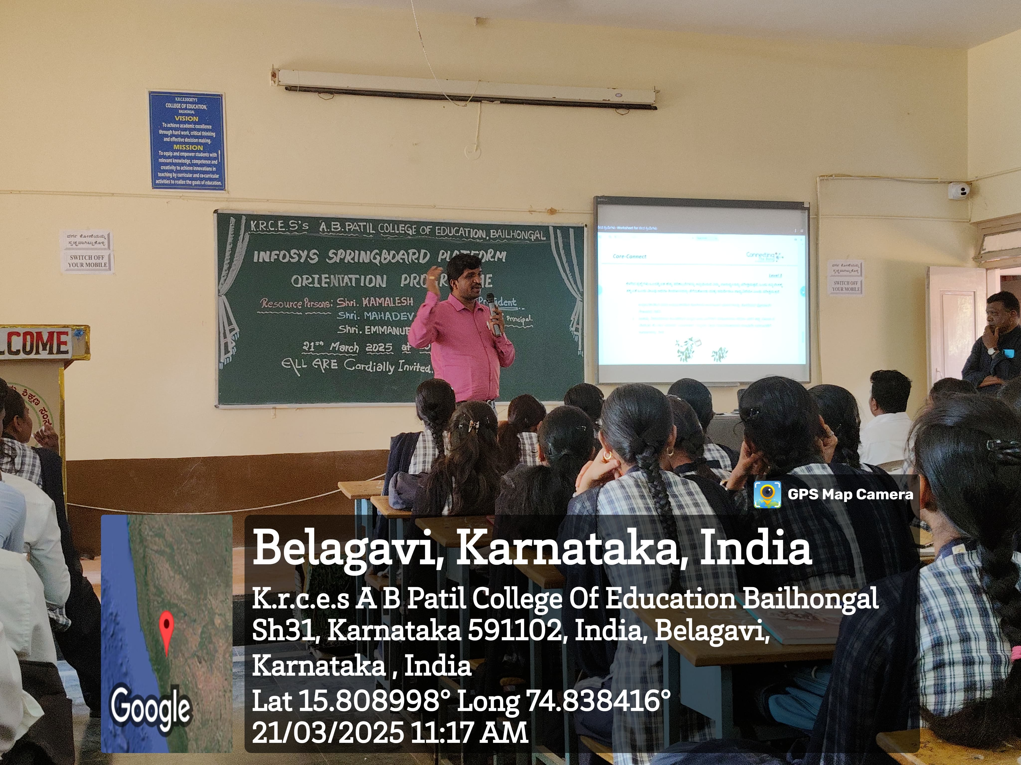

Slide 23
Best Practice No.2 : Development of Leadership Quality Among Students.
Objectives:
To identify talents among students and provide opportunity for development.
To develop critical thinking and problem solving skills.
To develop leadership qualities among students.
To help students set goals for individual growth and societal growth.

Slide 24
Activities:
Organization of Quiz Competition for school children by student teacher.
Rally on Girl Child Education.
Collage Making Competition on Gender Sensitization.
Active participation in NSS and CTC.
Role play based on social issues.
Tradition day activities.
Cultural Events organized by student teachers.

Slide 25
Organization of Quiz Competition for school children by student teacher.
Student teachers organized quiz competition based on the school curriculum on 28.9.2022.
All the nearby schools were invited for the competition and 11 practicing school students took participation.
Various rounds like Kannada, English, Hindi, Science, Social Studies, Mathematics, Sports, GK, Identification of sounds, identification of Pictures, were systematically carried out by student teachers.

Slide 26
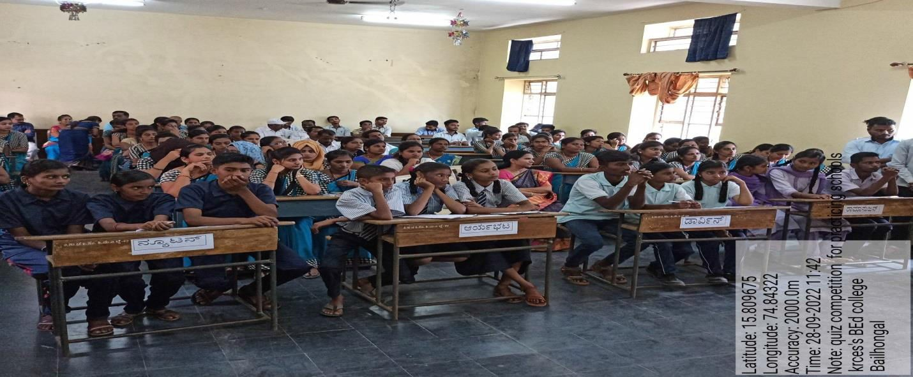
Evidence of the activities.

Slide 27
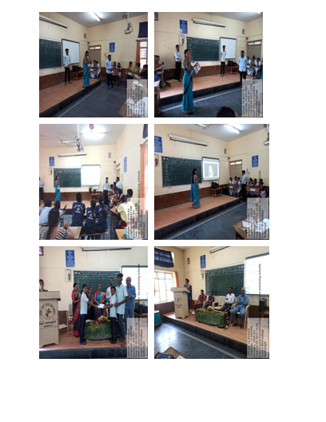

Slide 28
Rally on Girl Child Education.
Awareness Rally on “Education of Girl Child Education” On 21.12.2024, at 11.00 am, we conducted awareness rally at nearby village Bailwad.
Street play was performed by the student teachers on the significance of girl child education.
We received order from NCTE- NewDelhi, under National Gender Awareness Campaign; it was advised to conduct activities.
Inauguration of the rally was done by the Dr|| Hemalata. Primary Health Centre, Bailwad.

Slide 29
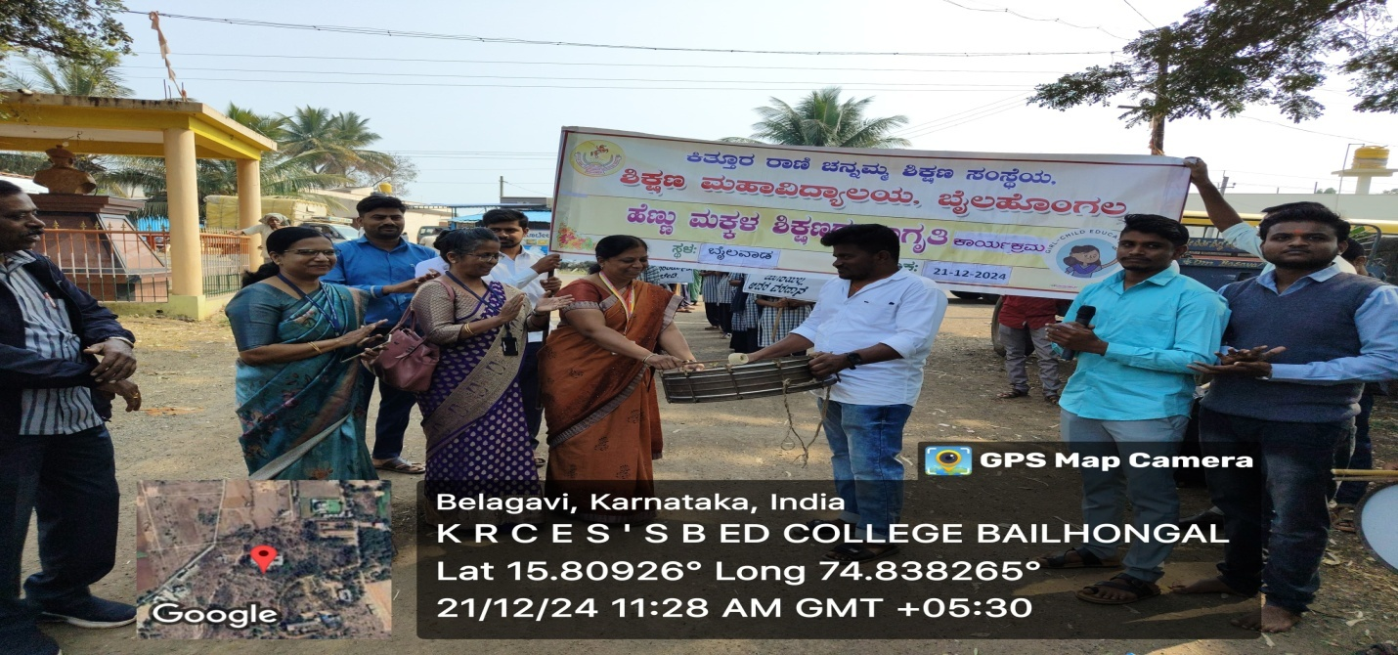

Slide 30
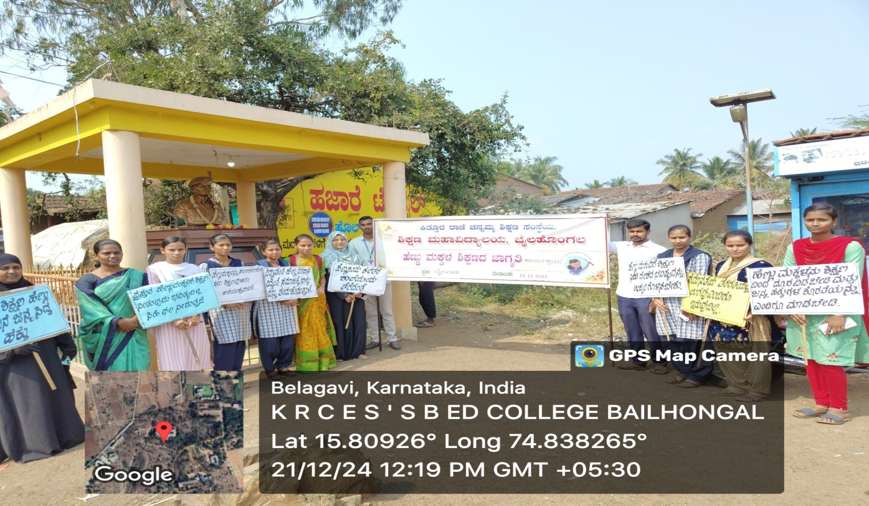

Slide 31
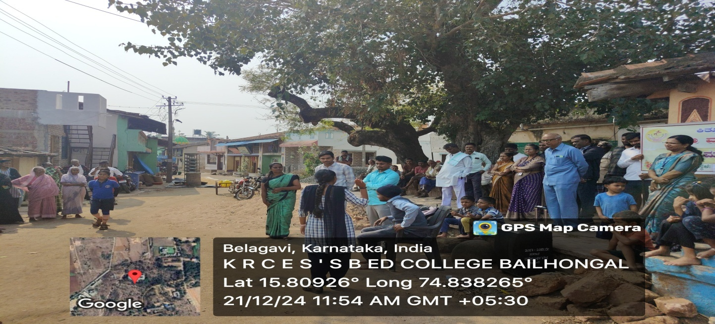

Slide 32
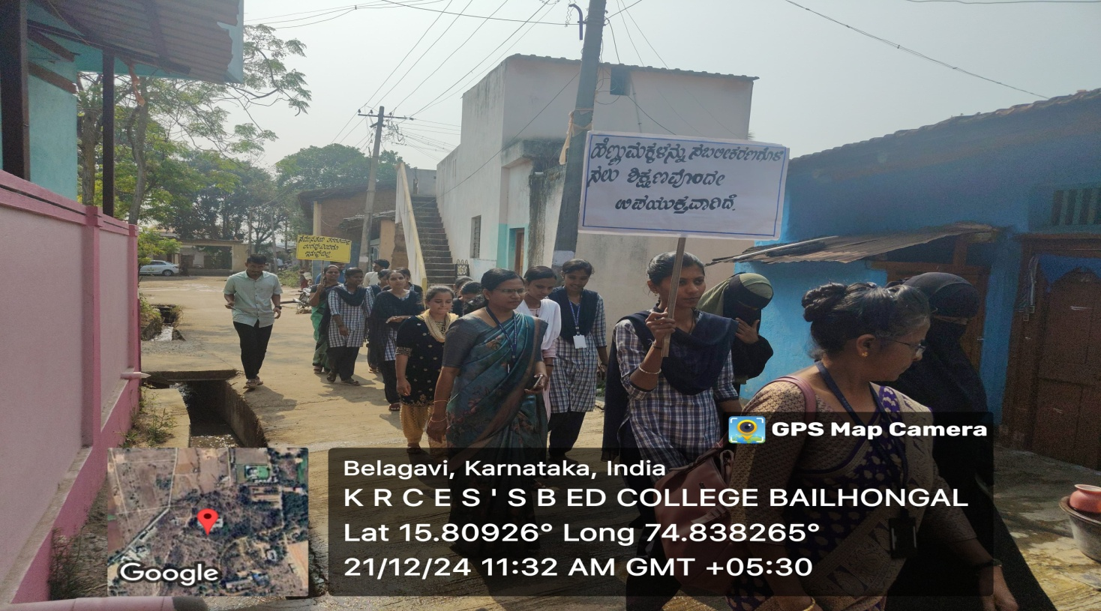

Slide 33
Organized Collage Making competition on Gender Sensitization held on 10.10.2023.
The objective of organizing this competition was to create awareness about problems of girl child and women in the society.
This competition was only for forth semester students as a part of their course subject, Gender, School and Society.
More than our expectations, students prepared and presented the collage in a vivid manner.

Slide 34
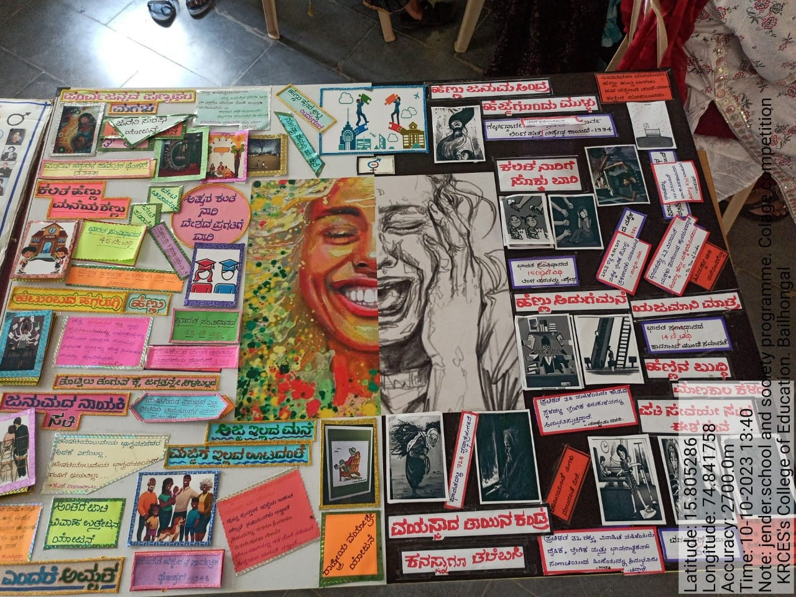

Slide 35
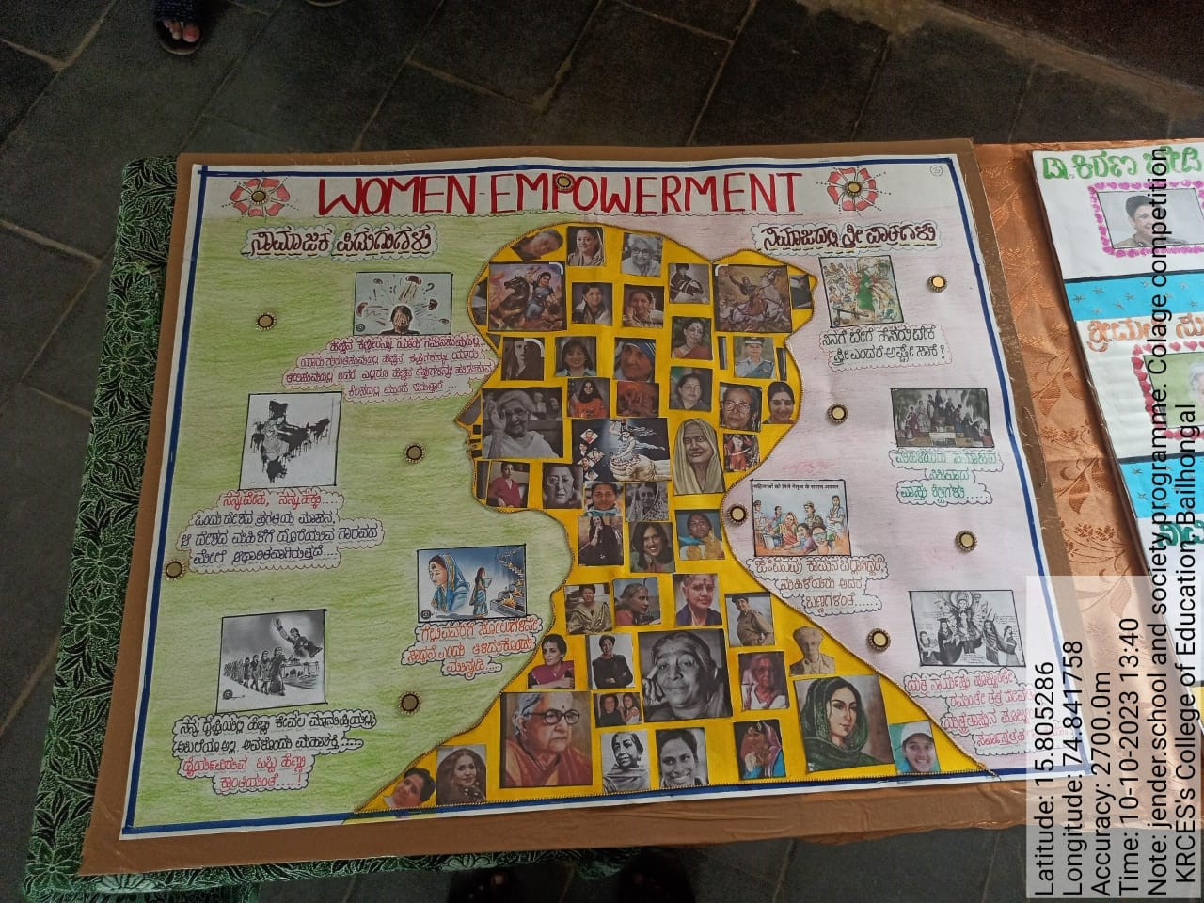

Slide 36
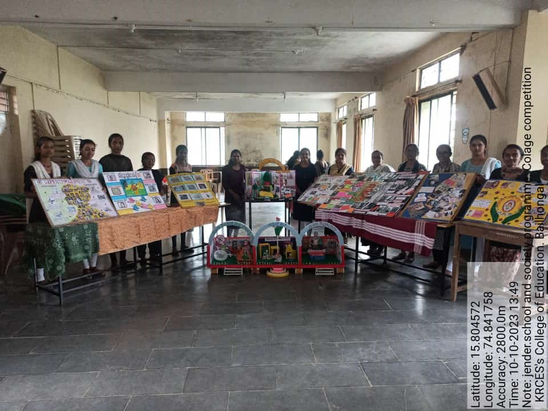

Slide 37
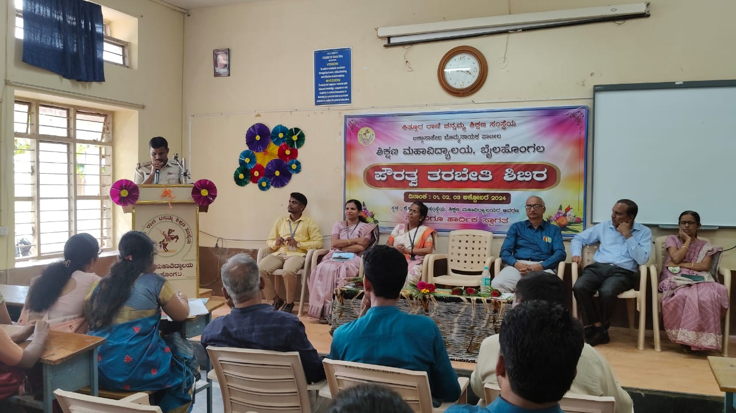
Active participation in CTC.

Slide 38
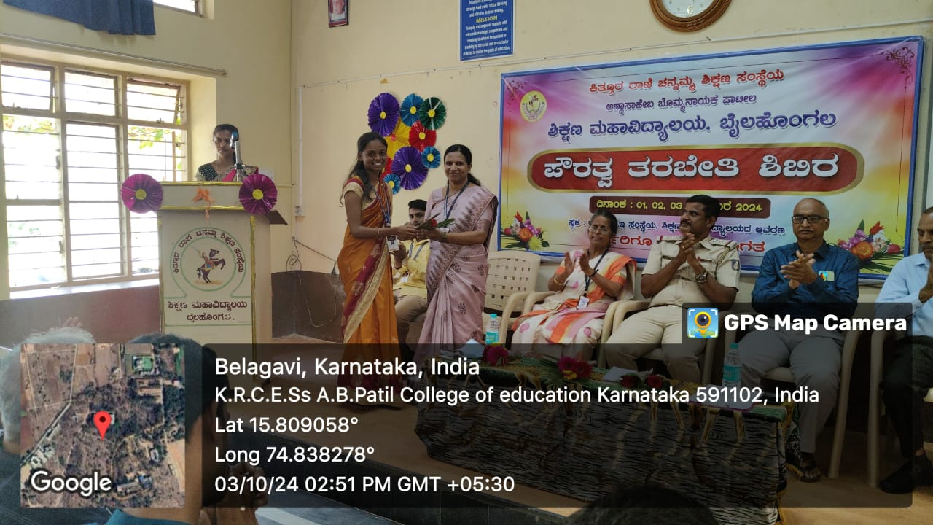

Slide 39
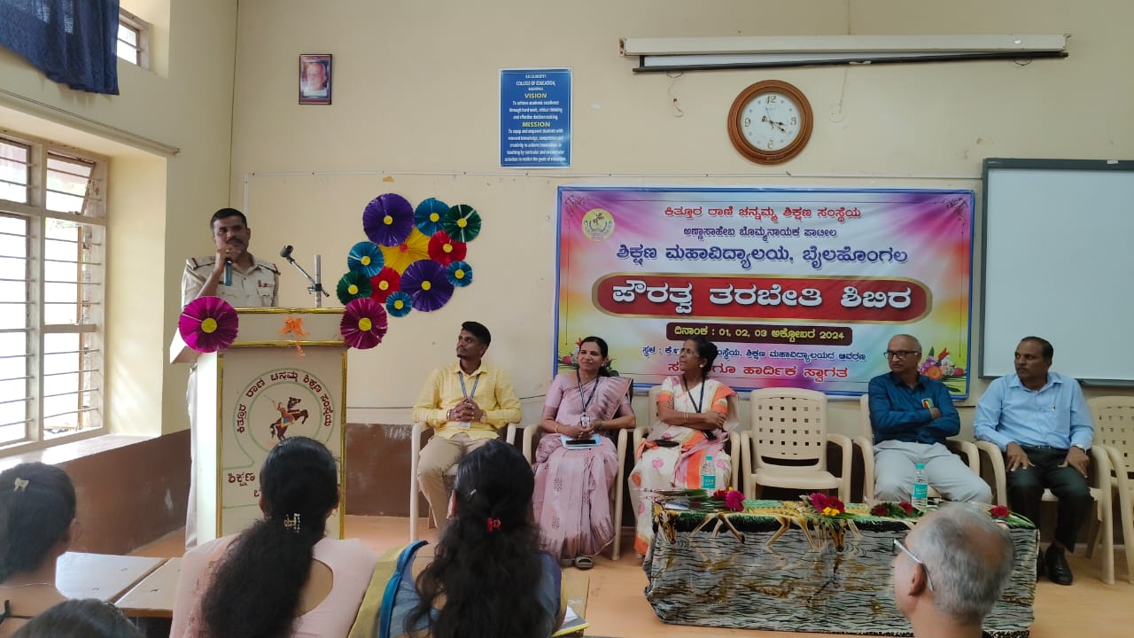

Slide 40
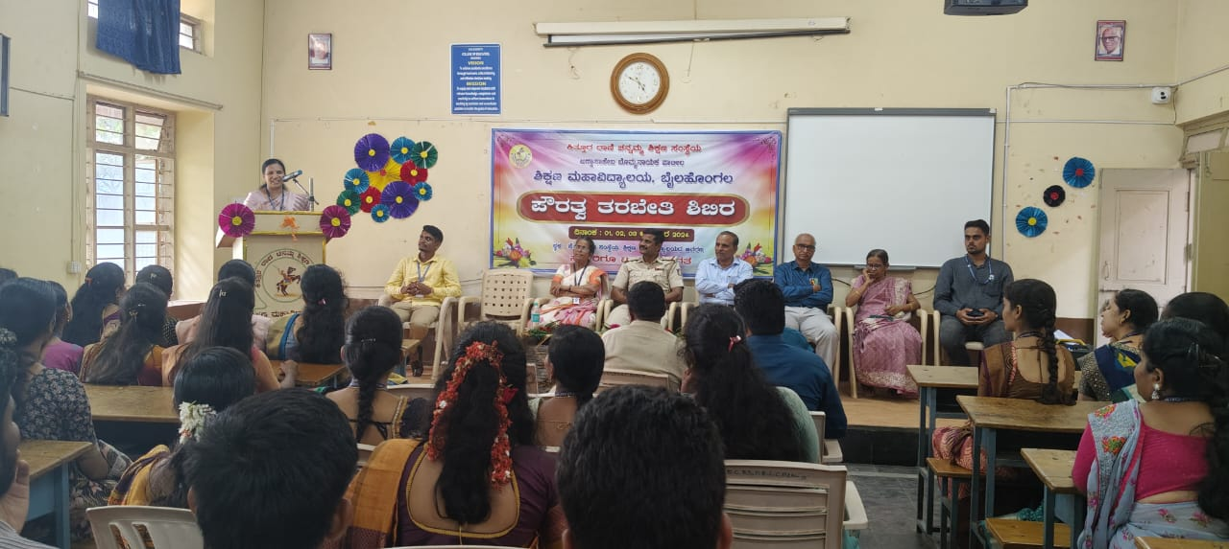

Slide 41
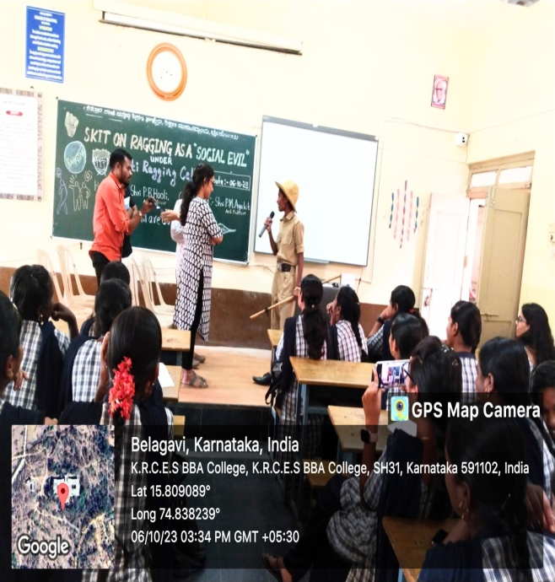
Role Play based on Social Issues held on 06.10.2023

Slide 42
